Slide 1
Working on PIPER
Also, MOPS
The Varied Summer of Adam Davis at NASA’s Goddard Space Flight Center
Code 665

Slide 2

Notes:
PIPER LOGO

Slide 3
PIPER
Primordial Inflation Polarization Explorer
Project Leader: Al Kogut
Will determine whether or not inflation actually occurred in the early universe
Inflation would be marked by an expansion of the universe so rapid that gravity waves form
These gravity waves can be detected indirectly by measuring the CMB (Cosmic Microwave Background) polarization

Slide 4
Superfluid
PIPER will measure this polarization by being sent up into the atmosphere while attached to a large balloon
The optics require cold temperatures, and superfluid liquid helium will be used to achieve this
Superfluid is a liquid cooled to such temperatures that it can pass through certain spaces that might even be air-tight
Liquid Helium, normally liquid at a temperature of 4 K, becomes partially superfluid at a temperature of approximately 2 K

Slide 5
My Task
Under the Direction and Assistance of Paul Mirel
This superfluid liquid helium must not be allowed to leak through the window seal at a rate faster than 10⁻⁸ mBar-Liters/sec for the optics to function properly, or else the detectors will not work
1 mBar-Liter/sec = 2.686x10¹⁹ helium atoms/sec
A testing procedure had been established, and my task was initially to analyze the leak rate for the Window Seal Tests using IDL, and later to look at the data in terms of the overall trends
Eventually, I became Test Director, proposing changes in the procedure and determining what time intervals we would use to collect the data

Slide 6
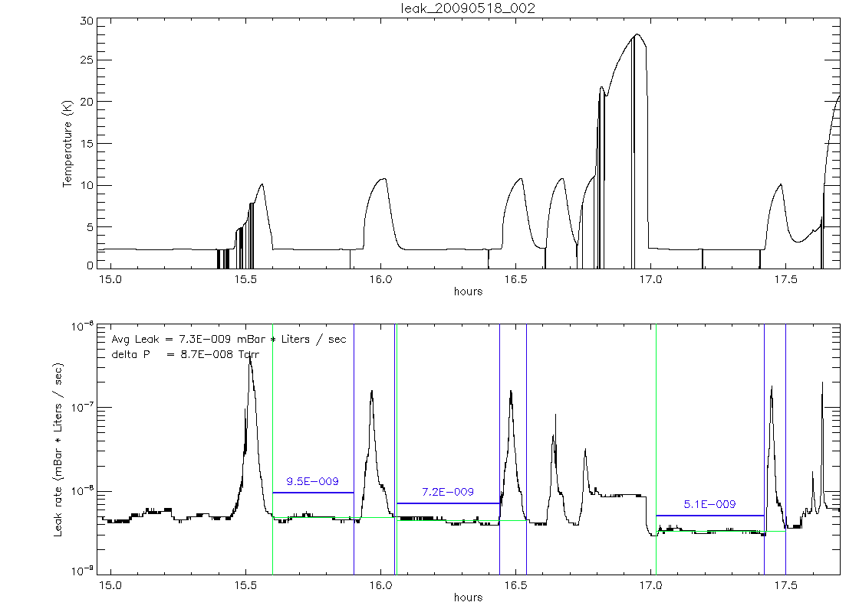
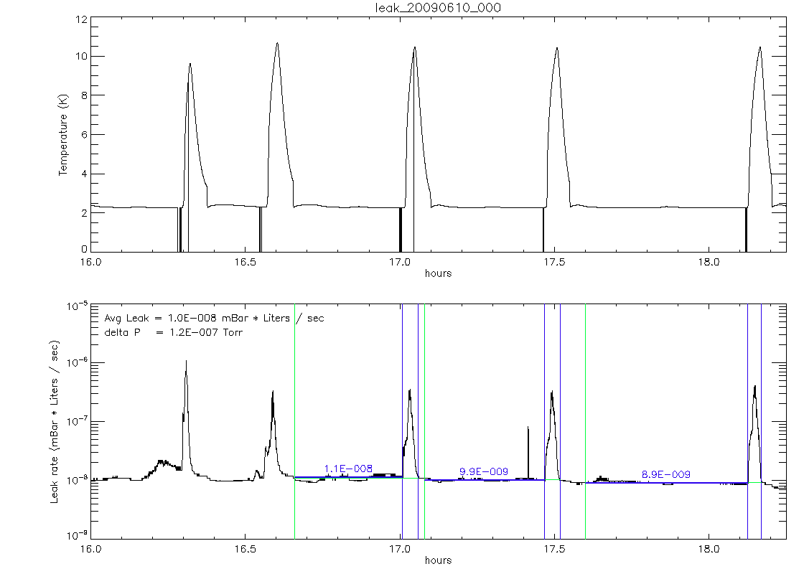
Learning and Using IDL
Thank you to Jamie Hinderks, Post-Doc
IDL is the acronym for Interactive Data Language
Began with a few practice programming exercises with IDL
Then began working with Jamie’s initial program to analyze the leak rate and plot the data as inputted from the text file
Began improving the analysis process
Applied Jamie’s recommendations to make other IDL programs for analysis purposes

Slide 7
How the Test is Conducted
Initial Preparations (About 5 Hours)
The window and the window seal are in the dewar (named Baby Bear), which is initially cooled using liquid nitrogen to approximately 77-108 K, and then further cooled with liquid helium to 4 K, the boiling temperature of helium
The bottom of the dewar is then partially filled with liquid helium
Because of the Ideal Gas Law (pV = nRT), to achieve the low superfluid temperature, the pressure must decrease, and so a pump is used to lower the pressure to below 1 Torr, at which point the helium is partly superfluid and will leak through the seal

Slide 8
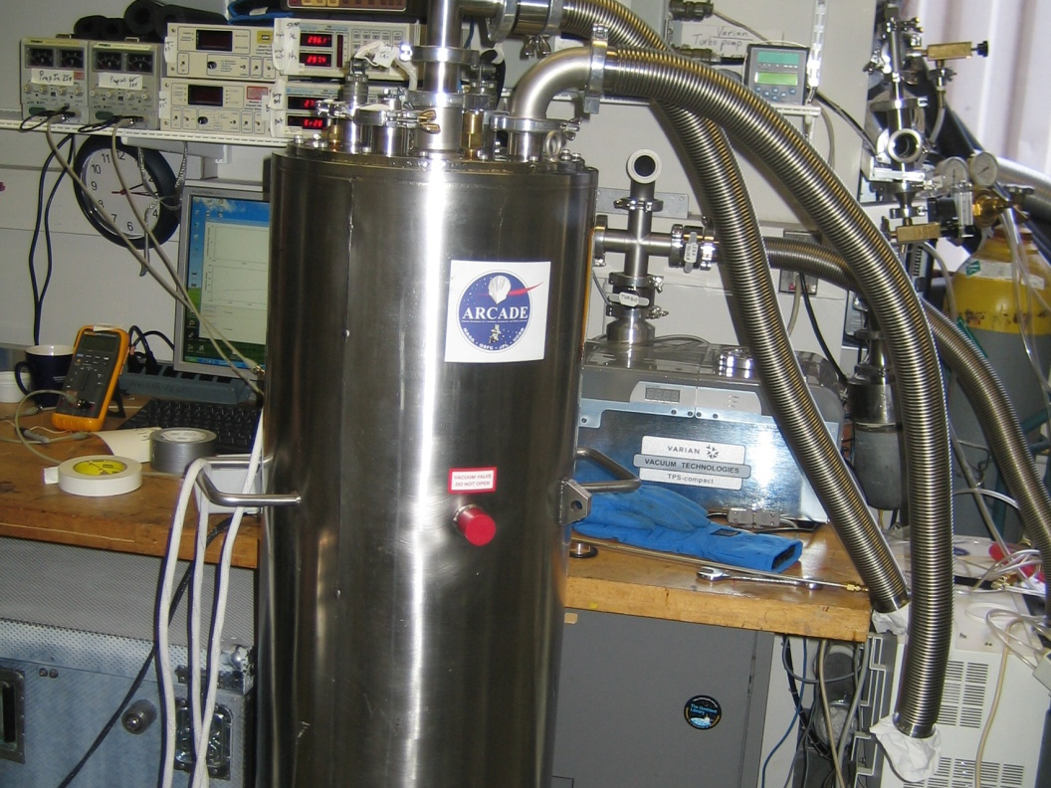
Baby Bear
We need to determine at what rate this leak occurs and whether or not it would be tolerable for the actual launch of PIPER

Slide 9
How the Test is Conducted
Data Collection Phase (About 5 Hours)
Some helium is pumped from the bottom of the dewar into a “soup can” in the middle of the dewar and given some time to leak through the window seal
It is then pumped out of the “soup can” and given some more time for residual superfluid helium to leak through
Because the leak detector can only detect helium in its gaseous state, the helium that has leaked through is boiled at about 10-12 K
This process is referred to as the bakeout
The sum of the helium detected during the bakeout is attributed to the leak throughout the entire time interval at a relatively constant rate
This whole sequence is repeated 3-6 times, depending on time constraints and amount of helium remaining

Slide 10
The Mathematics of the Data Analysis
In the collection of data, three measurements are made: time (in decimal hours), temperature (in Kelvin), and the instantaneous leak rate (in mBar-Liters/sec)
We take the time integral of the bakeout period, resulting in a total leak for that cycle, and this is divided over the entire length of time to determine an average leak for that cycle

Slide 11
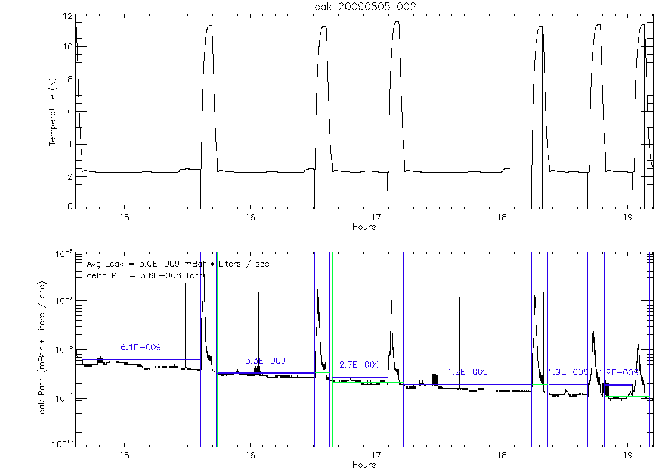
An Example: Our Most Recent Test

Slide 12
MOPS
Thank you to Dominic Benford and David Rapchun for Project Guidance
And to Jamie Hinderks and Luke Lowe for Assistance with Electronics and EAGLE

Slide 13
What is MOPS?
MOPS – Multi-Output Power Supply
Uses a USB input from a computer and a Digital to Analog Converter to input 0-10 V and output 0-40 V on four separate channels
Will be used to connect to heaters for a separate project

Slide 14
Stages of Development
Began with the initial hand-drawn layout process, determining initial values for components
Required me to read about electronics and learn the functions of operational amplifiers
Learned EAGLE and created a schematic and layout
The final step is the assembly of MOPS

Slide 15
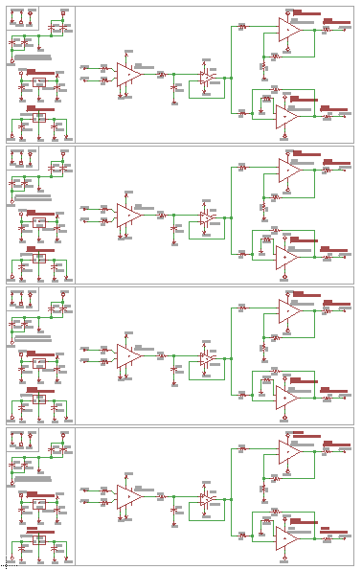
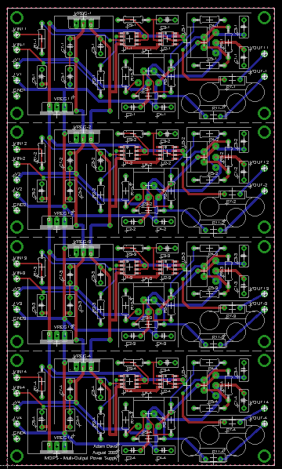
Schematic and Layout

Slide 16
Thank you!

